Slide 1
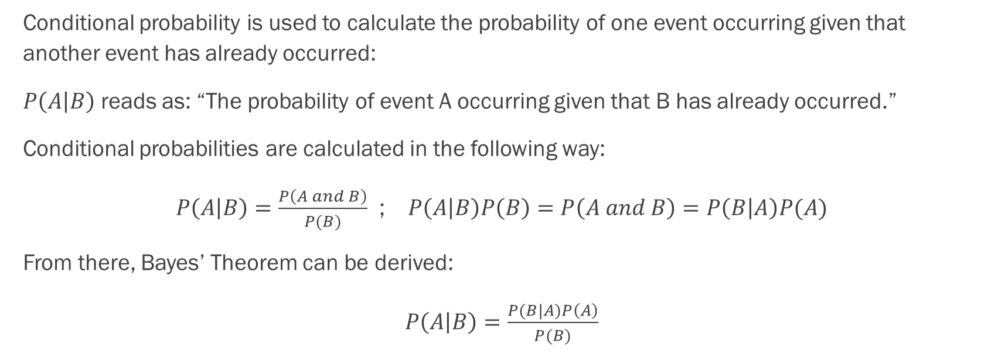
Naive Bayes: Conditional Probability Basics
Conditional probability is used to calculate the probability of one event occurring given that another event has already occurred:
$P\left(A | B\right)$ reads as: “The probability of event A occurring given that B has already occurred.”
Conditional probabilities are calculated in the following way:
$P\left(A | B\right)=\frac{P\left(A and B\right)}{P(B)}$ ; $P\left(A | B\right)P\left(B\right)=P\left(A and B\right)=P\left(B | A\right)P(A)$
From there, Bayes’ Theorem can be derived:
$P\left(A | B\right)=\frac{P(B|A)P\left(A\right)}{P(B)}$

Slide 2
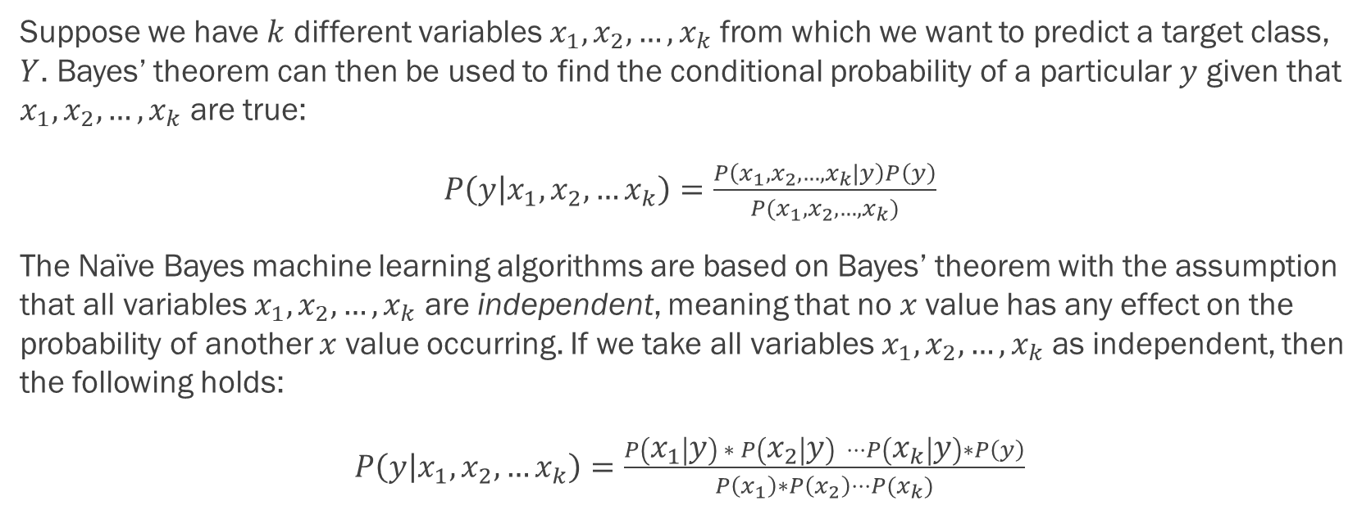
Naive Bayes: The Central Assumption
Suppose we have $k$ different variables $x_{1}, x_{2}, …, x_{k}$ from which we want to predict a target class, $Y$. Bayes’ theorem can then be used to find the conditional probability of a particular $y$ given that $x_{1}, x_{2}, …, x_{k}$ are true:
$P\left(y | x_{1},x_{2},…x_{k}\right)=\frac{P\left(x_{1},x_{2},…,x_{k}|y\right)P\left(y\right)}{P(x_{1},x_{2},…,x_{k})}$
The Naïve Bayes machine learning algorithms are based on Bayes’ theorem with the assumption that all variables $x_{1},x_{2},…,x_{k}$ are independent, meaning that no $x$value has any effect on the probability of another $x$ value occurring. If we take all variables $x_{1}, x_{2}, …, x_{k}$ as independent, then the following holds:
$P\left(y | x_{1},x_{2},…x_{k}\right)=\frac{P\left(x_{1} | y\right) ∗ P\left(x_{2} | y\right) ⋅⋅⋅P\left(x_{k} | y\right)∗P\left(y\right)}{P\left(x_{1}\right)∗P\left(x_{2}\right)⋅⋅⋅P(x_{k})}$

Slide 3
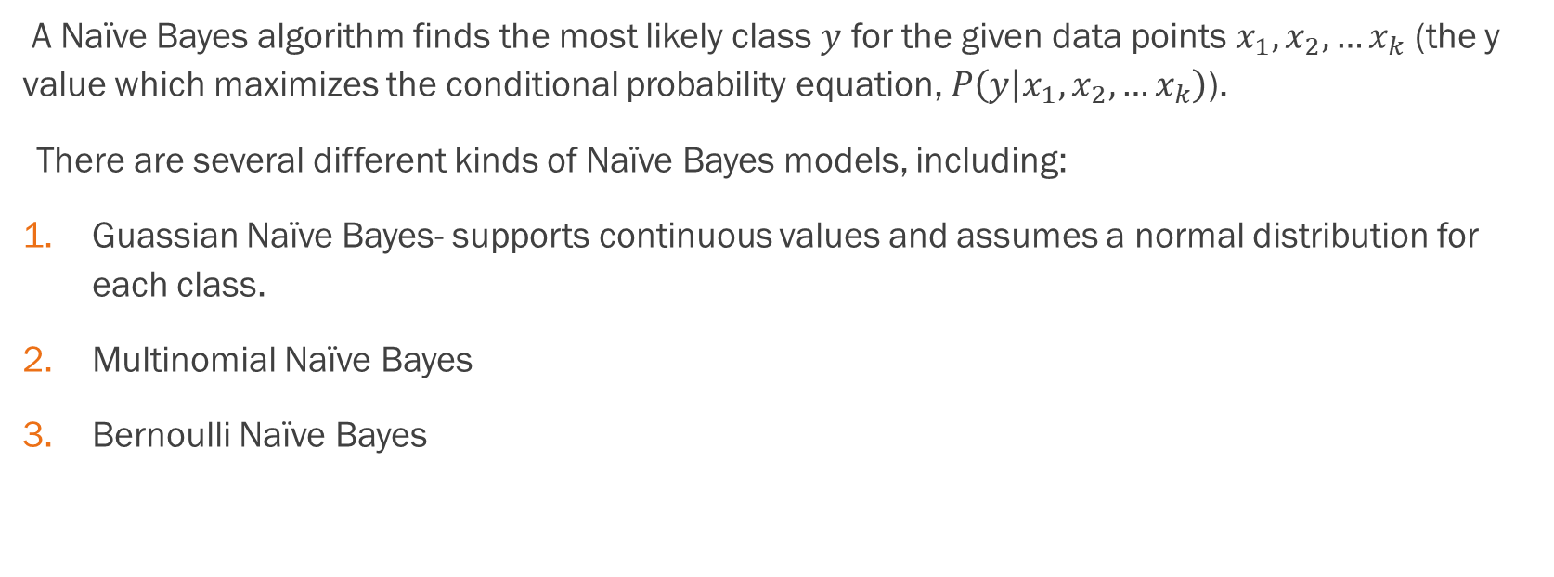
Naïve Bayes:
A Naïve Bayes algorithm finds the most likely class $y$ for the given data points $x_{1},x_{2},…x_{k}$ (the y value which maximizes the conditional probability equation, $P\left(y | x_{1},x_{2},…x_{k}\right)$).
There are several different kinds of Naïve Bayes models, including:
Guassian Naïve Bayes- supports continuous values and assumes a normal distribution for each class.
Multinomial Naïve Bayes
Bernoulli Naïve Bayes

Slide 4
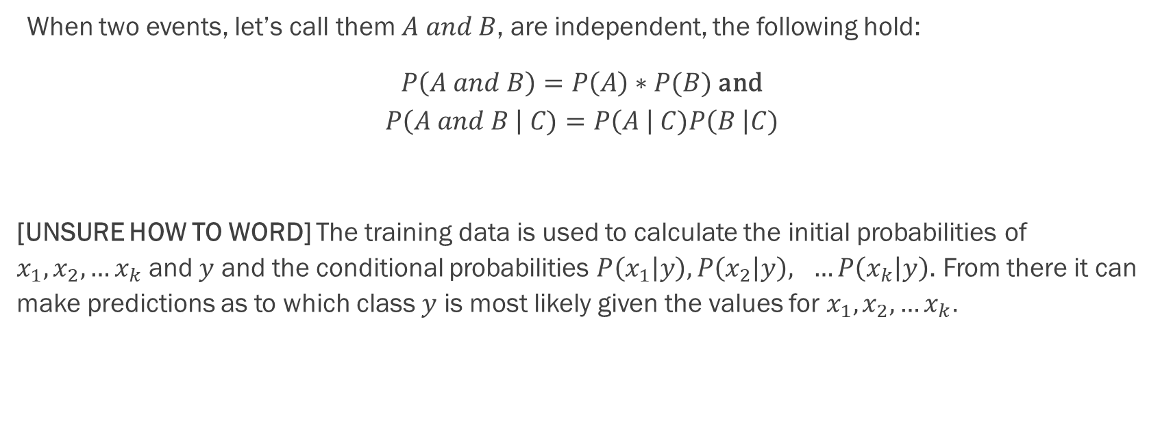
Junk
When two events, let’s call them $A and B$, are independent, the following hold:
$P\left(A and B\right)=P\left(A\right)∗P(B)$ and
$$P\left(A and B \right| C)=P\left(A \right| C)P\left(B \right|C)$$
[UNSURE HOW TO WORD] The training data is used to calculate the initial probabilities of $x_{1},x_{2},…x_{k}$ and $y$ and the conditional probabilities $P\left(x_{1} | y\right), P\left(x_{2} | y\right), …P\left(x_{k} | y\right)$. From there it can make predictions as to which class $y$ is most likely given the values for $x_{1},x_{2},…x_{k}.$

Slide 5
Advantages:
Simple to implement
Fast and effective in predicting the class of datasets
Doesn’t require a large test set to work well
Can handle both discrete and continuous data
Useful for text analysis and classification problems
Can be used for multiple class prediction problems

Slide 6
Disadvantages:
Relies upon the assumption that variables are independent
Not ideal for data sets with a large number of variables
Zero Frequency Problem

